Slide 1
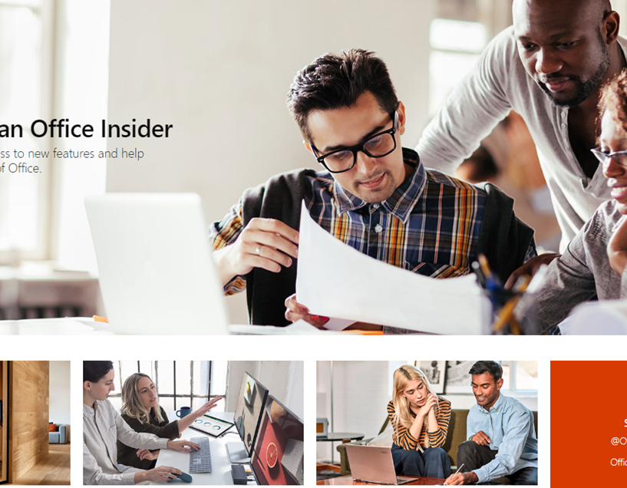
Office Insiders – Global Accessibility & Compliance
Business Need
The Office Insider team needed a Microsoft branded web application in 37 languages with attention to Accessibility standards and Microsoft Web Framework (MWF) design. Requirements included; integration of the Microsoft Universal header and footer (UHF), Microsoft Personal Account (MSA) authentication, and content authored in a CMS.
What We Did
Built a web application running on M365 content management system with an automated pipeline into Microsoft translation services; which produces the content of the web app in 37 languages.
Worked with the Office accessibility team to run full test passes against the site and fixed all bugs; in addition to cookie and privacy compliance signoffs.
Integrated all required Microsoft services such as UHF and MSA authentication and the Office Insider release notes system.
Ongoing Work
The Affirma engineering team continues to build in new features and designs based on the backlog in addition to keeping all solutions up to date with across Microsoft compliance initiatives.
Related Work -Windows Insiders
Contact : Suzie Yang | Product Marketing Manger | Windows Product Marketing Affirma Team : Jordan McDonald Dev Lead , Molly McGrath (PM)

